Slide 1
UECS2103 Operating Systems

Slide 2
Chapter 3
Process

Slide 3
Typical Functions of an Operating System Kernel
Process Management
Process creation, termination, scheduling, switching, synchronisation, inter-process communication, manage PCB
Memory Management
Allocation of address space to processes
Swapping, page and segment management
I/O Management
Buffer management, allocation of I/O channels and devices
Support Functions
Interrupt handling, accounting, monitoring

Slide 4
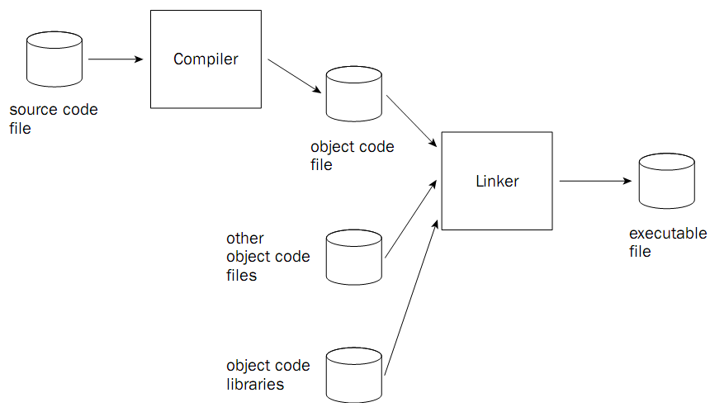
Process

Slide 5
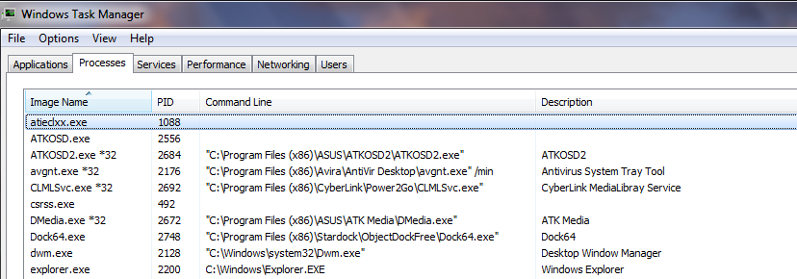
Process
Definition: A program in execution.

Slide 6
Process
Components in a process:
An executable program
Associated data needed by the program
Execution context (process state) of the program.
All information the operating system needs to manage the process, typically store in a Process Control Block

Slide 7
Process Control Block
Contains the process elements, divided into 3 categories:
Process Identification
Processor State Information
Process Control Information

Slide 8
Process Control Block
Contains 3 categories of process elements:
Process Identification
process identifier
parent identifier
user identifier

Slide 9
Process Control Block
Contains 3 categories of process elements:
Processor State Information
User-visible registers
Control and status registers
Program counter
Condition codes (result of arithmetic / logical operation)
Status information (interrupt enabled / disabled flag, execution mode)
Stack pointers (parameters, calling addresses for procedure / system calls are stored in stack)

Slide 10
Process Control Block
Contains 3 categories of process elements:
Process Control Information
Scheduling and State Information
Process State
Priority
Scheduling-related information
Event
Data structuring – queue, etc.
Inter-process communication (associated flags, signals & messages)
Process privileges
Memory management (pointers to segment / page tables)
Resource ownership and utilization (e.g. opened files)

Slide 11
Process Control Block
Created and manage by the operating system
Allows support for multiple processes
When a process is interrupted, the current values of program counter and the processor registers are saved in the appropriate fields of the corresponding PCB.
The state of process is changed to other value. For example, Blocked, or Ready.

Slide 12
Process
Process
Process
Process
Identification
Identification
Identification
Process
Processor State
Processor State
Processor State
Control
Information
Information
Information
Block
Process Control
Process Control
Process Control
Information
Information
Information
User Stack
User Stack
User Stack
Process
Image
Private User
Private User
Private User
Address Space
Address Space
Address Space
(Programs, Data)
(Programs, Data)
(Programs, Data)
Shared Address
Shared Address
Shared Address
Space
Space
Space
Process 1
Process 2
Process
n

Slide 13
Process
Elements in a Process Image:
User data – modifiable part of the user space. May include program data, user stack area and programs that may be modified.
User program – the program to be executed.
Stack – each process has one or more last-in-first-out (LIFO) stacks, to store parameters and calling addresses for procedure and system calls.
Process Control Block – contains data needed by OS to control the process.

Slide 14
Process
Reasons for process creation
New batch job | The OS is provided with a batch of job control stream, on tape or disk.
Interactive logon | An user logon to the system.
Created by OS | The OS can create process to perform a function on behalf of a user program without user having to wait. Example, a process to control printing.
Spawned by existing process | A user program can create processes.

Slide 15
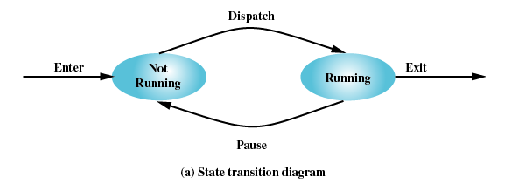
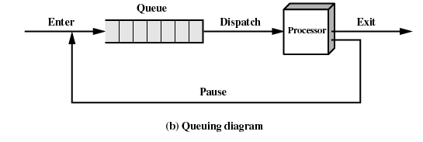
Process
2-State Process Model: A process may be in one of the two states:
Running
Not-running
Pointer to control block

Slide 16
2-State Process Model
Not-running processes are ready to execute but others are blocked (waiting for I/O)
Using a single queue, dispatcher cannot just select the process that has been in the queue the longest because it may be blocked
Scan the list looking for process that is not blocked and has been in the queue the longest.
Split the Not Running state into Ready and Blocked.

Slide 17
5-State Process Model
New – a newly created process but has not been admitted to the pool of executable processes, has not loaded into main memory.
Ready
Running
Blocked – a process that cannot execute until some events occurs (e.g. completion of I/O an operation)
Exit – a process that has been released from the pool of executable processes

Slide 18
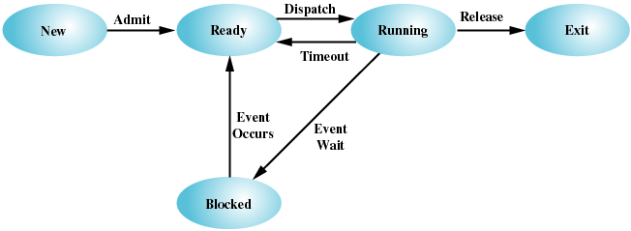
5-State Process Model

Slide 19
5-State Process Model – State Transition
New → Ready: when the OS is prepared to take on additional process. Most systems limit the number of existing processes or the virtual memory committed to existing processes (performance issue)

Slide 20
5-State Process Model – State Transition
Ready → Running: The OS will choose 1 of the processes in Ready state when it needs to select new process.

Slide 21
5-State Process Model – State Transition
Running → Ready: the running process has reached the maximum time allowed.
Running → Exit: The currently running process is terminated by OS when it has completed or it is aborts.

Slide 22
5-State Process Model – State Transition
Running → Blocked: when a process request something for which it must wait. A request to OS is usually in form of a system service call.

Slide 23
5-State Process Model – State Transition
Blocked → Ready: when the event for which it has been waiting has occurs.
Ready → Exit, Blocked → Exit (not shown in diagram): when a parent process terminates a child process.

Slide 24
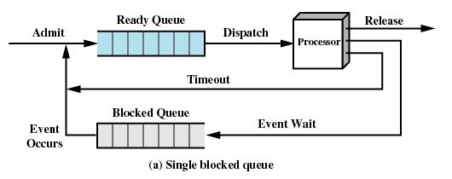
5-State Process Model
Using a single blocked queue, when an event occurs, the OS must scan the entire blocked queue, looking for the those processes waiting on that event → inefficient for a large OS.

Slide 25
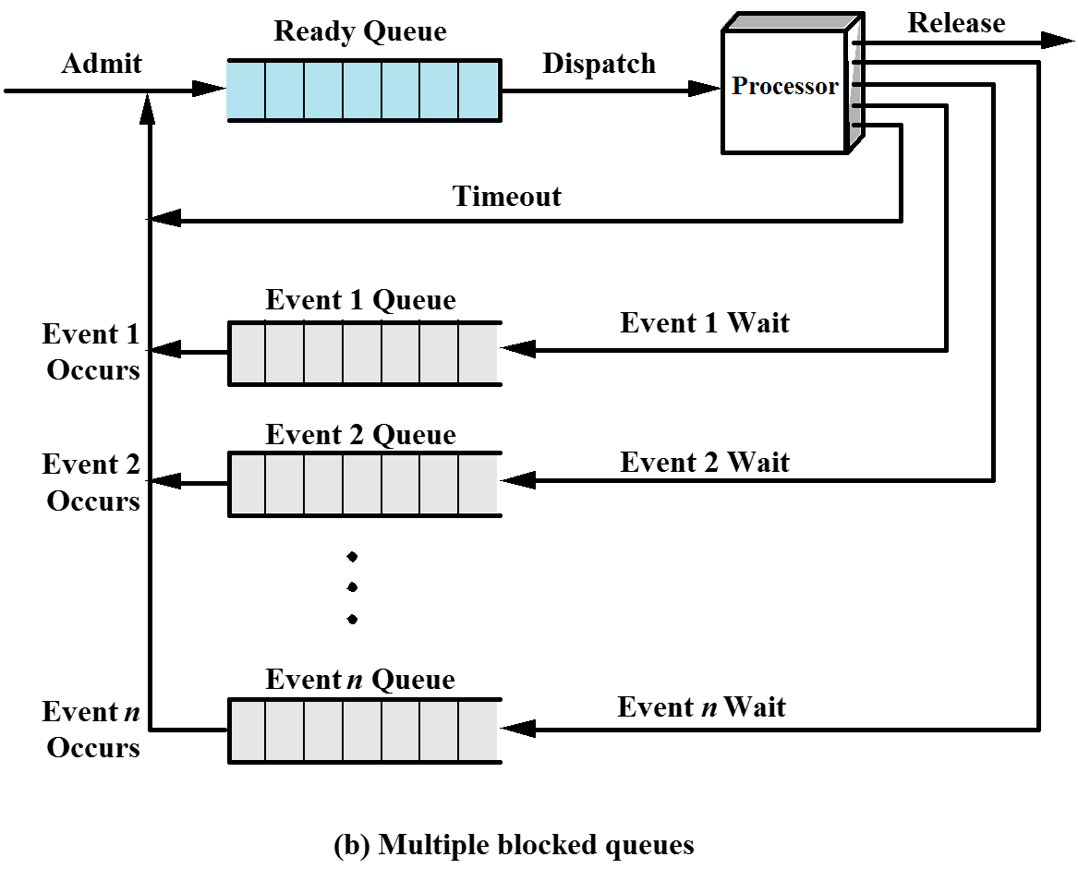
5-State Process Model

Slide 26
Suspended Processes
Processor is faster than I/O so all processes could be waiting for I/O, the processor could be idle most of the time if these processes are stored in memory.
Swap these processes to disk to free up more memory (swapping), when there are no ready processes in main memory.

Slide 27
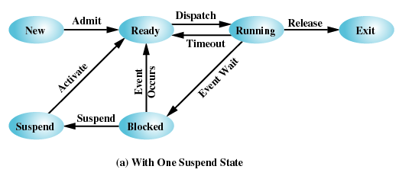
Suspended Processes
Blocked state becomes Suspend state when swapped to disk.

Slide 28
Suspended Processes
Two new states
Blocked/Suspend: the process is in secondary storage, waiting an event.
Ready/Suspend: the process is in secondary storage, but ready for execution as soon as it is loaded into main memory.

Slide 29
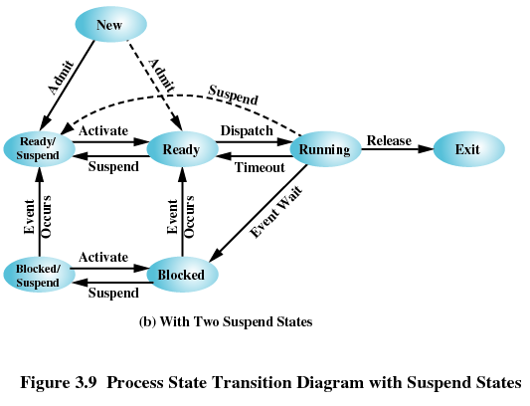
Suspended Processes
Possible but not necessary transition

Slide 30
Suspended Processes – New Transitions
Blocked → Blocked/Suspend
When there are no ready processes, at least one process is swapped out.
If there are ready processes, but the currently running process or a ready process requires more main memory, at least one process still need to be swapped out.
Blocked/Suspend → Ready/Suspend
When the event for which a process has been waiting occurs.

Slide 31
Suspended Processes – New Transitions
Ready/Suspend → Ready
When there are no ready processes in main memory or a ready/suspend process has higher priority than other ready processes.
Ready → Ready/Suspend
If that is the only way to free up a large block of main memory.
OS may suspend lower priority ready process rather than a higher priority blocked process

Slide 32
Suspended Processes - Characteristics
The process is not immediately available for execution.
The process was placed in a suspended state by an agent: either itself, a parent process, or the OS, for the purpose of preventing its execution.
The process may or may not be waiting on an event.
The process may not be removed from this state until the agent explicitly orders the removal.

Slide 33
Suspended Processes - Characteristics
Swapping | The OS needs to release sufficient main memory to bring in a process that is ready to execute.
Other OS reason | The OS may suspend a background or utility process or a process that is suspected of causing a problem.
Interactive user request | User may wish to suspend execution of a program for purposes of debugging or in connection with the use of a resource.
Timing | A process may be executed periodically (e.g. an accounting or system monitoring process) and may be suspended while waiting for the next time interval.
Parent process request | A parent process may wish to suspend execution of a descendent to examine or modify the suspended process, or to coordinate the activity of various descendent.

Slide 34
Exercise
Process A is a new process and the execution cycles are as below:
Process A executes
Time out (clock interrupt)
Process A continues to execute
Process A waiting for I/O operation
Process A continues to execute
Process A terminate
State the changes of process state based on 5-state model.

Slide 35
Exercise
A photo management program is executed; hence, a new process, P, is created. The program will first copy all new photos from a digital camera before it can perform any operation to the photos. While the program is waiting for the file to be copied, the OS switches the execution to another process , C. However, process P must be swapped out from main memory to gain more memory for process C. When the copy operation is completed, process C is interrupted and process P continues to execute until it is interrupted as its time slice exhausted. Process P continues after a while and it executes until it terminates. List the state transitions of process P based on 7-state model.

Slide 36
Operating System Control Structures
Manage processes and resources – information about the current status of each process and resource needed.
Tables are constructed for each entity the operating system manages
Types of tables:
Memory
I/O
File
Process

Slide 37
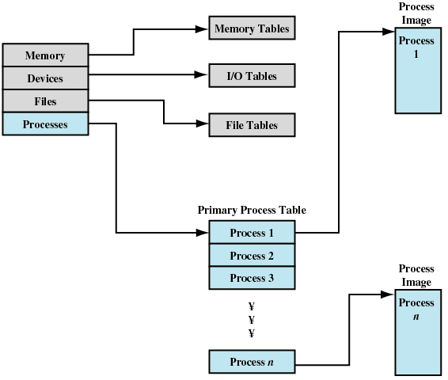
Operating System Control Structures

Slide 38
OS Control Structure – Memory Table
Keep track main and secondary memory.
Information in tables:
Allocation of main memory to processes
Allocation of secondary memory to processes
Protection attributes for access to shared memory regions
Information needed to manage virtual memory

Slide 39
OS Control Structure – I/O Table
Information in tables:
I/O device may be available or assigned
Status of I/O operation (if I/O operation is in progress)
Location in main memory being used as the source or destination of the I/O transfer

Slide 40
OS Control Structure – File Table
Provide the following information
Existence of files
Location of files on secondary memory
Current status of files
Other attributes
Sometimes the information is maintained by a file management system, not the OS

Slide 41
OS Control Structure – Process Table
Where process is located?
Information about process:
Program
Data
Stack – each process has 1 or more LIFO system stacks, used to store parameters & calling addresses for procedure & system calls
Attributes used by OS (PCB)
All the information refer as process image.

Slide 42
Execution Modes
User mode
Less-privileged mode
User programs typically execute in this mode
System mode, control mode, or kernel mode: more-privileged mode
Mode switch may occur without changing the Running state of a process, thus involve little overhead.

Slide 43
Process Creation
Assign a unique process identifier to the new process
Allocate space for the process
Initialize process control block
Set up appropriate linkages
Example: add new process to linked list used for scheduling queue
Create or expand other data structures
Example: maintain an accounting file

Slide 44
Process Switching
Process switching usually occurs when it is interrupted.
Mechanisms for Interrupting the Execution of a Process:
Mechanism | Cause | Use
Interrupt | External to the execution of the current instruction | Reaction to an asynchronous external event
Trap | Associated with the execution of the current instruction | Handling of an error or an exception condition
Supervisor call | Explicit request | Call to an operating system function

Slide 45
Process Switching
Interrupt
Due to some sort of event that is external to and independent of the currently running process
Clock interrupt
I/O interrupt
Memory fault
memory address is in virtual memory so it must be brought into main memory
Time slice
The maximum amount of time that a process can execute before being interrupted

Slide 46
Process Switching
Trap
An error or exception condition generated within the currently running process
OS determines if the condition is fatal
moved to the Exit state and a process switch occurs
action will depend on the nature of the error
Supervisor call
such as file open (the execution will be transferred to corresponding routine, which is part of operating system code)

Slide 47
Process Switching
Steps in process switching
Save context of processor including program counter and other registers
Update the process control block of the currently running process (change process state, update relevant fields)
Move process control block to appropriate queue
Select another process for execution
Update the process control block of the process selected
Update memory-management data structures
Restore context of the selected process

